Slide 1
De-Identification in Healthcare Information Systems
Department of Computer Science
800 W. Campbell Road Richardson, TX 75080-3021
https://cs.utdallas.edu/
Raed Salih, Ph.D.
raed.salih@utdallas.edu

Slide 2
De-Identification in Healthcare Information Systems Department of Computer Science
Project Background:
De-identification protects individual privacy by removing personally identifiable information (PII) from data, allowing its use for research, statistical analysis, and public health tracking.

Slide 3
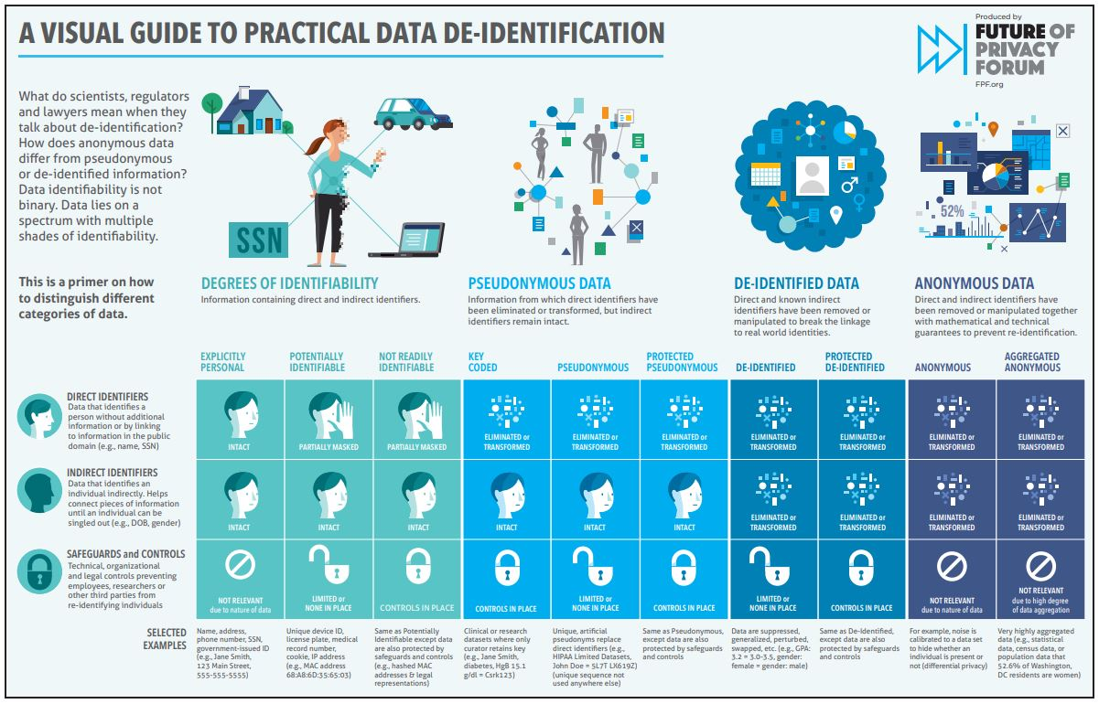

Slide 4
De-Identification in Healthcare Information Systems Department of Computer Science
Under HIPAA (the U.S. Health Insurance Portability and Accountability Act of 1996), Protected Health Information (PHI) encompasses any data related to a person's health, healthcare services received, or payment for those services that can be used to identify them.
Examples: Names, Addresses, email Addresses, SSN … etc.
HIPAA's Privacy Rule protects PHI to ensure the privacy and confidentiality of individuals' health information.
De-identification methods safeguard PHI while enabling its use for research, statistical analysis, and public health tracking.

Slide 5
De-Identification in Healthcare Information Systems Department of Computer Science
PHI lookup List
Names;
SSN;
Doctor Name…
Plain Text (includes PHI)
…
…
…
De-Identification
Method
Plain Text (includes de-Identification of PHI)
…
…
…
Name: Smith Well
DoB: 11/23/1959
Name: ** Name **
DoB: **MM/DD/YYYY**

Slide 6
De-Identification in Healthcare Information Systems Department of Computer Science
What we will do ( as a team):
learn in a Research and Development (R&D) setting.
R&D is essential for staying ahead of the curve, driving progress, and ensuring long-term success in today's competitive global economy.
We will do:
Applied Research

Slide 7
De-Identification in Healthcare Information Systems Department of Computer Science
R&D:
1. Literature Review
Gather existing knowledge: Conduct a thorough review of relevant research papers, patents, and other publications.
2. Research Design
Plan the research: Determine the methodology, data collection techniques.
Consider ethical implications: Ensure that the research adheres to ethical guidelines.
3. Development and Prototyping
Create a prototype: Develop a working model or prototype of your proposed solution.
Test and refine: Evaluate the prototype and make necessary adjustments.
4. Reporting
Communicating the findings of a study to a wider audience.

Slide 8
De-Identification in Healthcare Information Systems Department of Computer Science
What you will do:
Read papers & write summaries
Develop programming skills of regular Expression( find words and parsing) within larger body of text.
Put application’s specification and requirements
Do your task
Write code, review code, and test code
Project Product (application):
An application to identify PHI data, remove them from the body of text, and replace them with de-identified elements (tags).

Slide 9
De-Identification in Healthcare Information Systems Department of Computer Science
Communication Style and Meeting
Communication Style
We do “Assertive communication”:
What progress have you made?
What challenges are you facing?
What's your plan moving forward?
Email (raed.salih@utdallas.edu)
Meeting
Project Kickoff meeting -All R&D Teams- TBA
Weekly Meeting (MS Team) Each R&D team (15 min) -TBA
My Office hour- TBA

Slide 10
De-Identification in Healthcare Information Systems Department of Computer Science
The Grading Criteria and Process
- Project Proposal/Requirements: (Midterm grade, see the intro slides for details)
- Final Report (FR) includes Design document, Test plan/cases, Implementation, Testing Results, user manual, Sponsor Approval Form, poster & one-slide, presentation)
- Final Grade(FG) is based on the final report (FR), oral presentation/poster session (P), sponsor/faculty advisor feedback (SF/FAF), Meeting Attendance (MA) and peer review (PR).
Review the intro slides for details:
FG~=FR*(AVERAGE(SF, FAF)*0.80+P*0.1+MA*0.05+PR*0.05)/100
Faculty Advisor Feedback (SF/FAF)
-Meeting Attending, Tasks performance, Reporting (communication style) .

Slide 11
Extra slides
Student Learning Objectives/Outcomes
Students that successfully complete this class will have the:
1. Ability to write detailed requirements from a customer's minimal project specification
2. Ability to do requirements analysis with a customer
3. Ability to write a project proposal based on the refined requirement specification
4. Ability to work in a team and contribute to a team software design project
5. Ability to work in a team and contribute to the production of an enterprise software product
6. Ability to meet milestones and final goals in a team environment
7. Ability to write a final report fully documenting the design of a software design project
8. Ability to present to others the work of the team
9. Ability to independently research and learn new programming languages, platforms, and/or design approaches required to develop industrial applications

